Slide 1
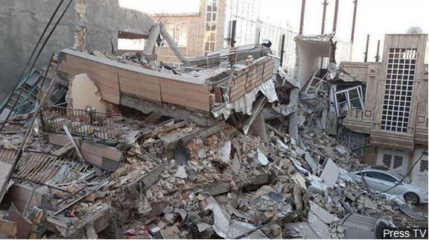
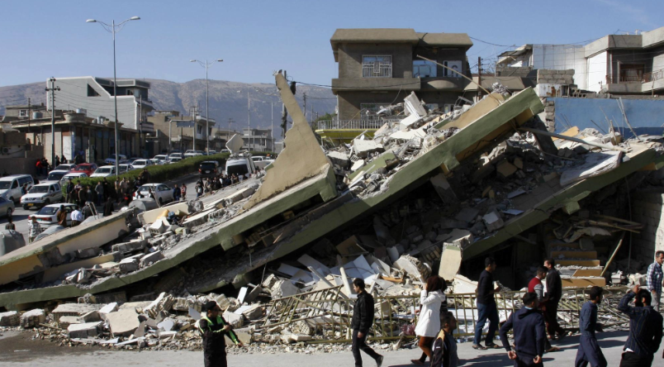
How(UAVs) are used in Disaster Management

Slide 2
What is UAV?
UAV (Unmanned Aerial Vehicle):
Is a type of an aircraft that operates with out human pilot on board. UAV can be remote controlled aircraft, or can fly autonomously based on preprogrammed flight plan.

Slide 3
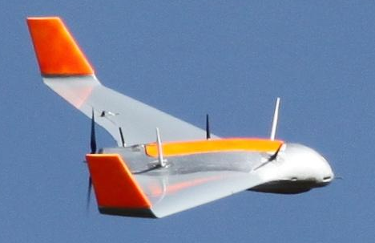
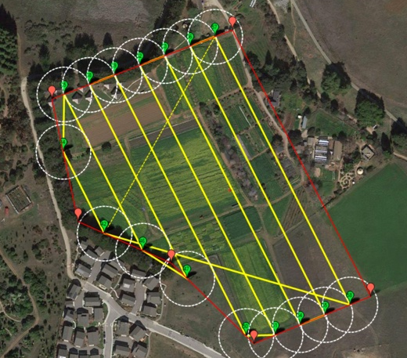
Flight planning
Autonomous
Remotely controlled

Slide 4
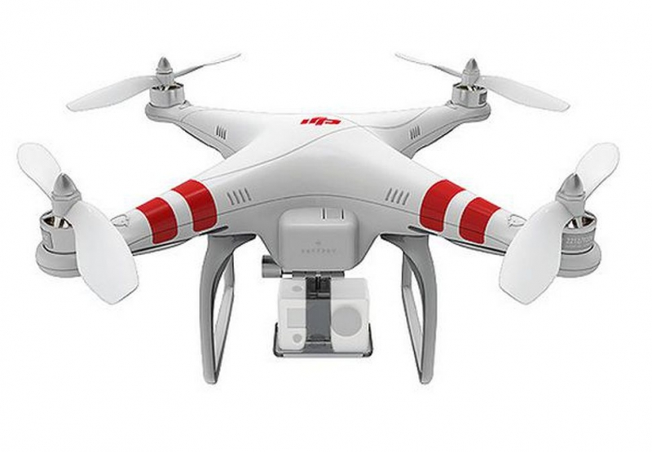
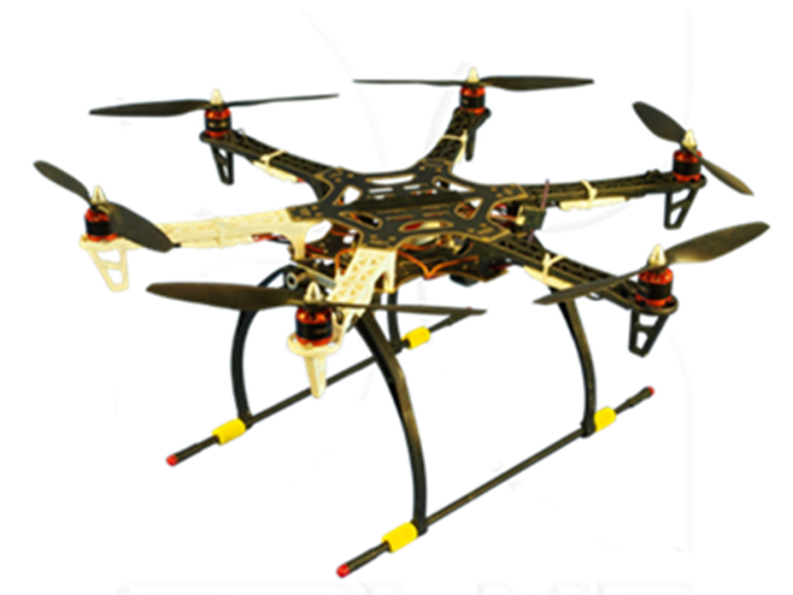
Types of UAV
Rotary wings
Uses 2 or more rotating blades that revolve around fixed mast to generate the lift

Slide 5
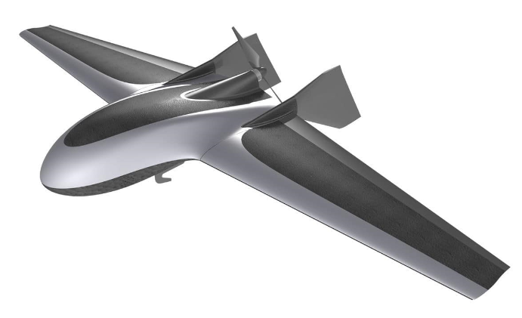
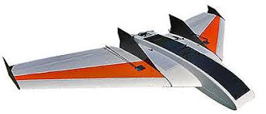
Fixed wing: Uses a fixed wing like normal airplane to provide the lift

Slide 6
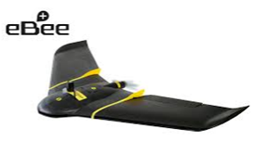
UAV Specification
eBee Plus SenseFly UAV
1.1 kg weight
Wingspan 110cm
3 km radio link range
45 minute maximum flight time
Payload consists of sensors, wireless communication equipment, RTK/PPK system for positioning (accuracy 3-5cm)

Slide 7
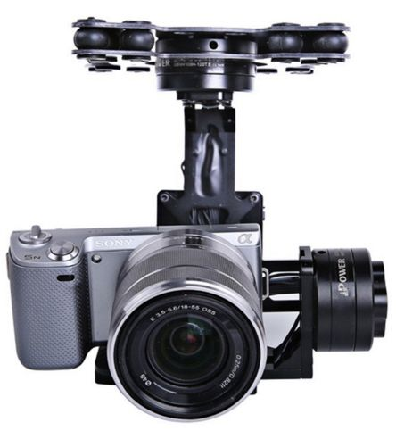
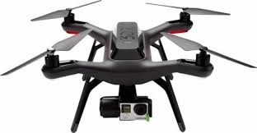
Mapping Sensors
1-Digital Camera
Used for day operation they include video camera and high definition photographic equipment.

Slide 8
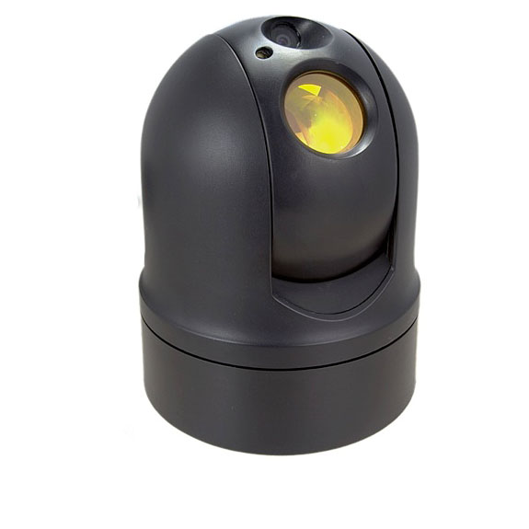
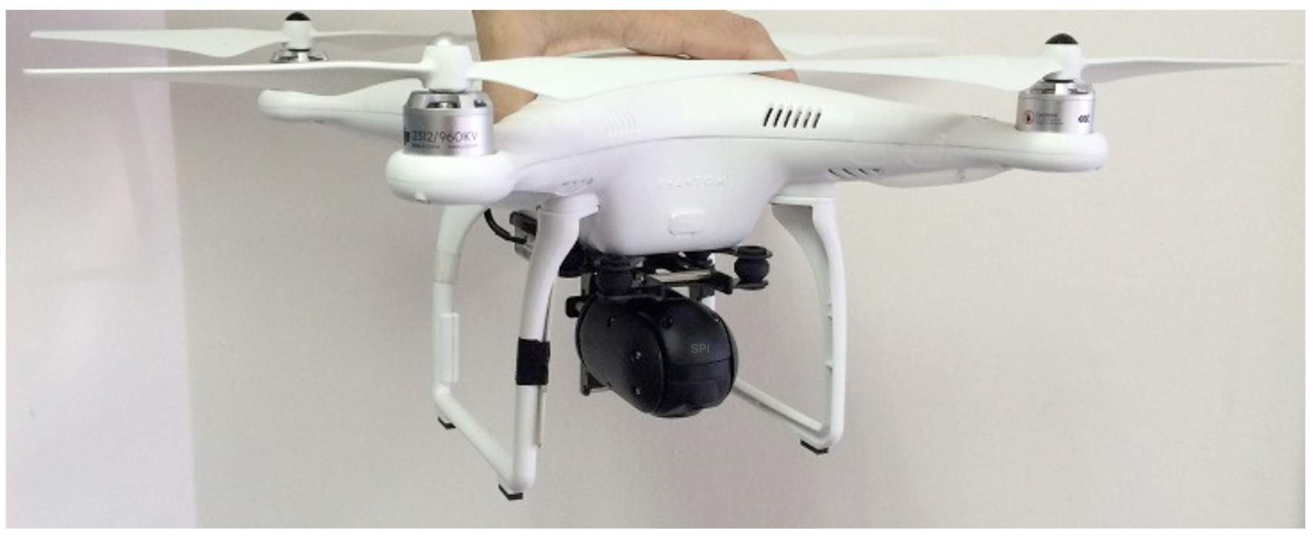
2- Infrared sensors:
They are used for night vision, and heat sensing.

Slide 9
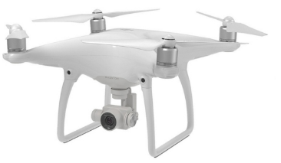
3-Light Detection And Ranging (LiDAR)
A surveying tool used for creating point cloud and digital elevation models of the ground.
(Point cloud is a set of data points in 3D coordinates, represents the external surface of the object)

Slide 10
UAV photogrammetric products include:
DSM / DTM (3D Models)
Orthophoto (geospatially corrected aerial images)
Contour Plans
Topographic Maps
High definition Digital Images.

Slide 11
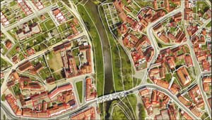
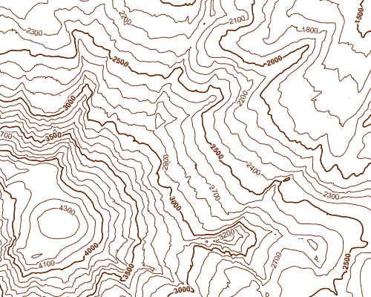
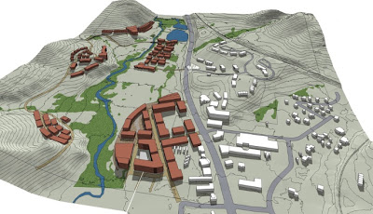
UAV photogrammetric products
Digital Terrain Model (DTM) Digital Surface Model (DSM)
Orthophoto
Contour Line Plan
3D Model

Slide 12
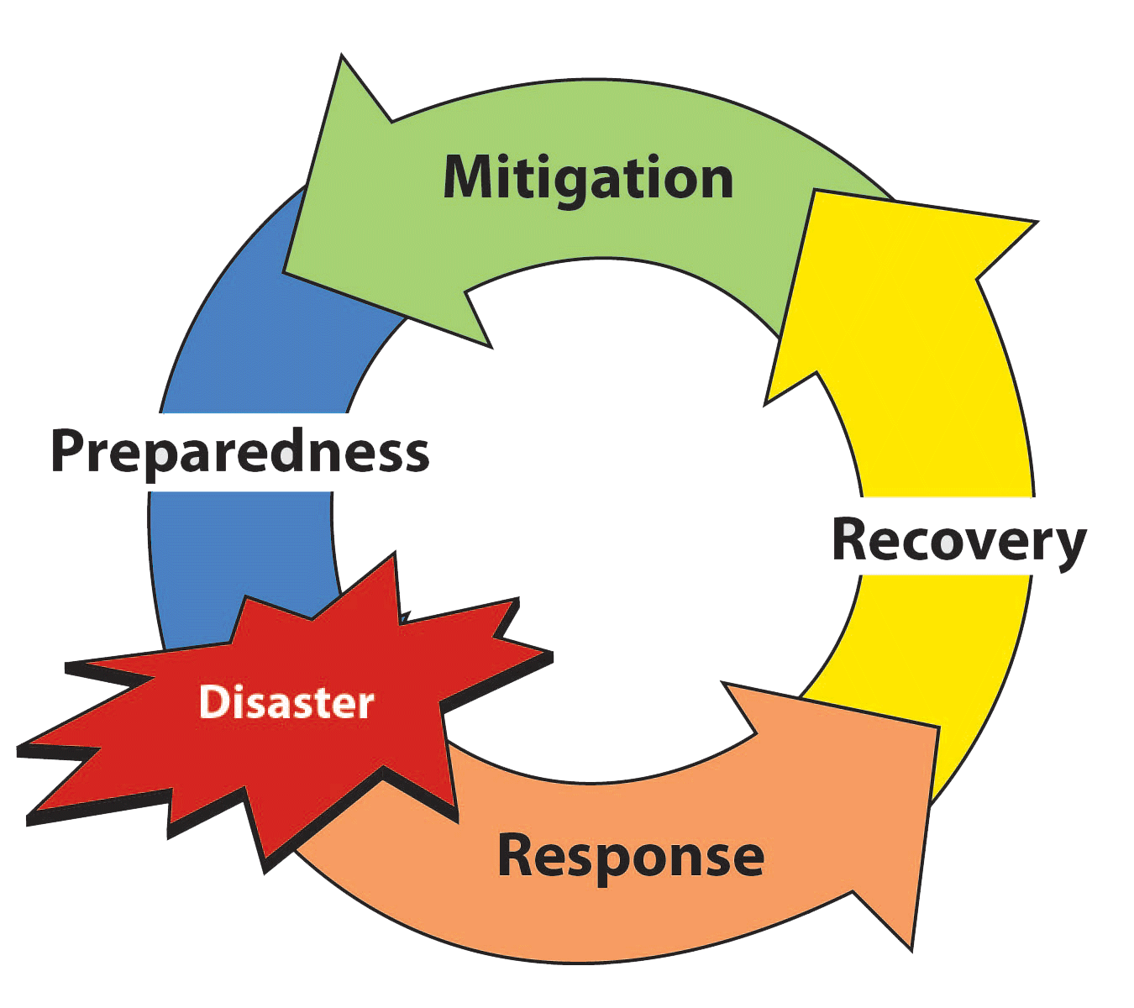
Four phases of Disaster Management

Slide 13
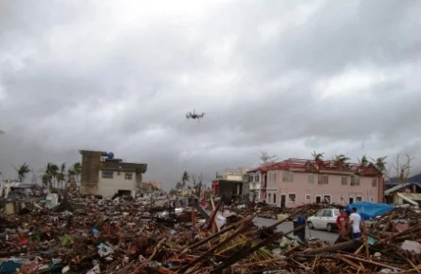
UAV Application in Disaster Management

Slide 14
UAVs – Preparedness
UAVs can assist in many areas of pre-disaster preparedness and planning:
* Mapping, determining hazard areas, evacuation routes and safe zones
* Determine locations for pre-placement and deployment of resources
* Preplanning and familiarization for tactical and strategic responses
* Support of training and exercise activities

Slide 15
UAVs - Response
UAVs can support many missions during the Response Phase of a disaster including:
* Provide real time situational awareness including locations of threats and hazards
* Survey damaged or assess conditions in inaccessible disaster areas
* Determine status of roads and critical infrastructure
* Provide geospatial references and navigation
* Monitor response operations and its effectiveness
* Assist Search and Rescue Operations

Slide 16
UAVs - Recovery
The Recovery Phase is historically the longest phase of a disaster response:
* Survey damaged areas and structures
* Provide geospatial references and navigation
* Determine status of roads and critical infrastructure
* Monitor recovery operations and effectiveness
* Monitor the movement of persons, vehicles and resources
* Provide support for security operations

Slide 17
UAVs - Mitigation
*UAVs have many applications that can assist authorities in mitigation efforts:
* Surveying new land for settlement
* Monitoring snow melt, storm runoff to prevent flooding
* Determine status of transportation routes
* preparation of maps and documents for pre-disaster conditions.

Slide 18
Conclusion
- UAVs can save lives, property,
- UAVs are a reasonably low cost solution for disaster management
- UAV data are used to create 3D models, when compared with historical data, offers new perspectives of the extent of the damage.
- UAV data are used in planning, construction for new settlements.

Slide 19
THANK YOU

