Slide 1
New Trends in IoT: 5G, SDN, NFV and Slicing
Tara Yahiya
Assistant Professor
Computer Science & Engineering Dept.
t.ibrahim1@ukh.edu.krd

Slide 2
Current Trend in IoT (1)

Slide 3
Current Trend in IoT (2)
Network Operations
Low cost operations; Network Slicing; Cloud-native
UR-LLC
(Mission Critical Services)
$$$$$$/Yr/Device
Low latency; Reliability
Massive MTC (IoT)
$/Yr/Device; Low power;
eMBB
$$$/Yr/Device
High bandwidth
Vehicular
(telemetry, driver assist, autonomous, etc.)
$$$/Yr/Device; High mobility

Slide 4
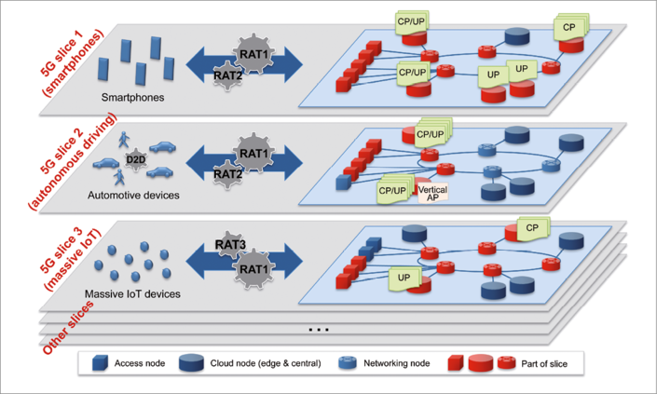
Network Slicing and IoT

Slide 5
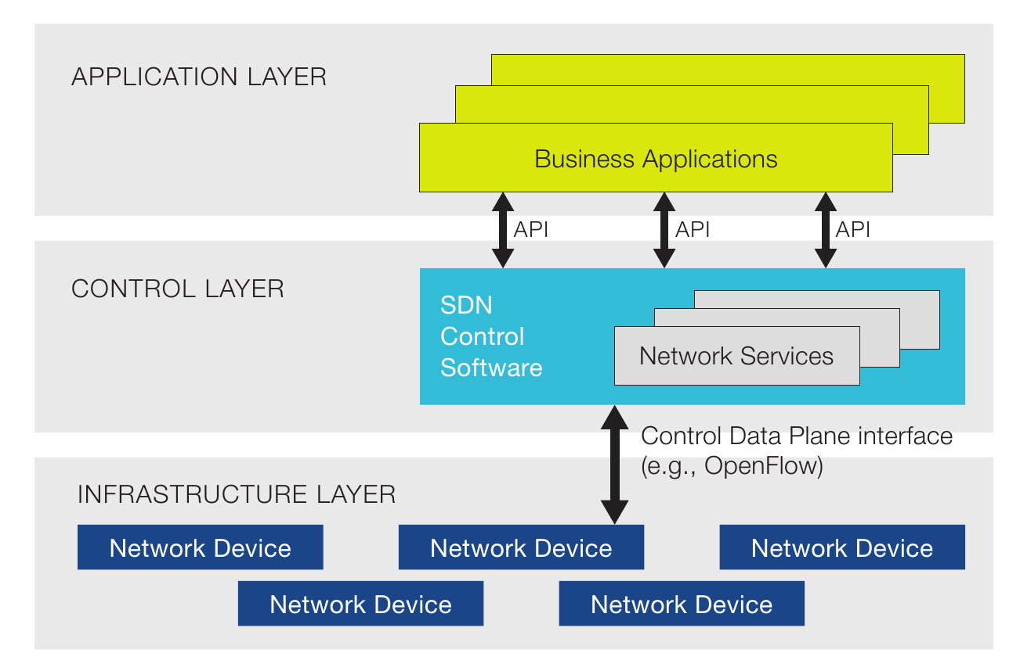
Software Defined Network

Slide 6
Network Functions Virtualization

Slide 7
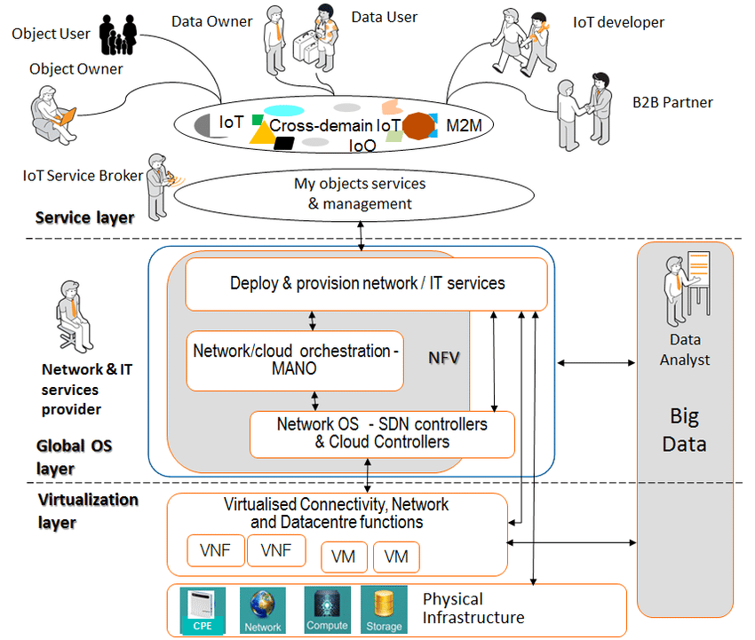
IoT, SDN, NFV in one slice

Slide 8
Thanks for your attention
Any question ???

