Slide 1
IoT Fundamentals & Digital Transformation
Emerging Technologies Curriculum
Dler Z. Mawlod
Cisco Academy Support Center Advisor
February 27, 2018

Slide 2
Digital Transformation Education Perfect Storm
Massive Youth
Growing
Unprecedented
Unemployment
Skills Shortage
Opportunity
74M
63%
$11.1T
Unemployed Youth
of CEOs see lack of skills
Economic Value
as a serious concern
Add by 2025
M
c
Kinsey Center for Government,
PWC, 17
th
Annual
M
c
Kinsey Global Institute; IoT: Mapping
Education to Employment
Global CEO Survey
the Value Beyond the Hype
© 2017 Cisco and/or its affiliates. All rights reserved. Cisco Confidential
3

Slide 3
Digital Technology Impact
Everything
Everything
Everything
Everything
Everything
becomes
becomes
generates
can be
needs to be
connected
software-based
data
automated
secured
© 2017 Cisco and/or its affiliates. All rights reserved. Cisco Confidential
4

Slide 4
Digital Transformation
Connections
•
Internet traffic will be 92 times
Automation
greater than in 2020 than
•
Only about 0.5 percent of
2005
data is currently ever
•
26.3 billion networked
analyzed.
devices and connections
•
AI bots will power 85% of
Software Based
customer service
interactions by 2020
•
“Shift to Cloud” will affect $1
Trillion in spending by 2020
Security
Data Volume
•
Global spending on
cybersecurity predicted to
•
More data created in past
exceed $1 trillion over the
two years than entire
next five years
previous history of the
human race.
Source: Global Center for Digital Business Transformation, 2015
© 2017 Cisco and/or its affiliates. All rights reserved. Cisco Confidential
5

Slide 5
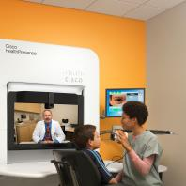
Digital Transformation across Countries and Companies
IoT merges
physical and virtual
worlds, creating smart
environments
Digitization change the sector in the:
User Experience with Digital Products
Processes and Value Chain
Business Model
Smart
Smart
Smart
Smart
City
Hospital
Highway
Factory
© 2017 Cisco and/or its affiliates. All rights reserved. Cisco Confidential
7

Slide 6
IoT Fundamentals Curriculum
Overview
Career Prep
Learning Components
IoT Fundamentals is a multi-
The skills developed in the curriculum
•
Connecting Things course
disciplinary, hands-on, curriculum
is the starting point to prepare for
•
Big Data & Analytics course
teaching how to ideate, prototype
employer-validated entry-level job
•
Hackathon Playbook course
and articulate the business value
families like:
of an “end-to-end IoT Solution”.
•
Cisco Prototyping Lab
The curriculum provides a strong
•
IoT Device Management
Cisco Packet Tracer (PT 7)
IoT Product Manager
•
skills and design-thinking foundation
•
for IoT job families that exist today
•
IoT Data Analytics
and in the future.
Features
Develop entrepreneurial and social impact mindset through highly engaging hands-on and simulated learning activities
including Prototyping Lab and Packet Tracer 7.0 to develop:
•
21st Century Skills such as Creativity, Critical thinking, Collaboration and Communication
•
Rapid prototyping with Sensors, Electronics and Arduino
•
Use visual programming or Python to program a Raspberry Pi
•
Connect with Cloud Services using RESTful APIs
•
Collect, store and visualize data from sensors in real time
•
Apply analytics to gain insights from data
© 2017 Cisco and/or its affiliates. All rights reserved. Cisco Confidential
8
•
Present IoT solutions and their business value

Slide 7
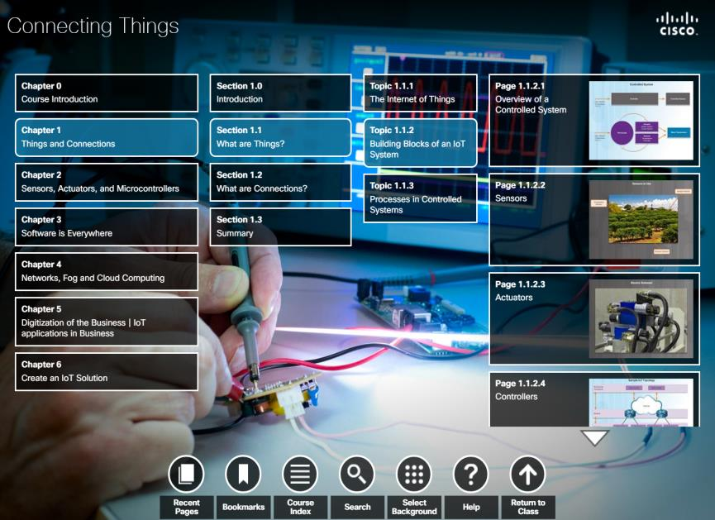
IoT Fundamentals:
Connecting Things
Course Overview
In Connecting Things, students learn how to securely interconnect
sensors, actuators, microcontrollers, single-board computers, and cloud
services over IP networks to create an end-to-end IoT system.
Benefits
Students will develop the interdisciplinary skillsets required to prototype
an IoT solution for a specific business case with a strong focus on the
security considerations for emerging technologies.
Learning Components
Features
Target Audience: Secondary, Vocational, 2-year and 4-year
•
Understand and explain the
•
Understand the relevant aspects
College, 4-Year University students
concepts, opportunities and
of cybersecurity and privacy for
Prerequisites: Basic programming, networking and
challenges of digital
an IoT solution.
electronics
transformation using IoT.
•
Understand how digitalization
Languages: English
•
Interconnect sensors/actuators,
is changing vertical markets such
Course Delivery: Instructor-led
microcontrollers (Arduino), Single
as manufacturing, energy, and
Estimated Time to Complete: 40-50 hours
Board Computers (Raspberry Pi)
smart cars.
and cloud services (Cisco Spark
Use simulation tools (Packet
Recommended Next Course: IoT Fundamentals: Big Data &
restful API) to create an end-to-
•
Analytics or Hackathon Playbook
end IoT system.
Tracer) to create end-to-end
© 2017 Cisco and/or its affiliates. All rights reserved. Cisco Confidential
10
IoT system.
Instructor Training: Required

Slide 8
Connecting Things Course Outline
Chapter
Chapter Titles
Summary Description
1
Things and Connections
Understand the building blocks, the interconnections and the information flow of
an IoT System.
2
Sensors, Actuators and
Use sensors and an Arduino microcontroller to read data from physical world
microcontrollers
and control actuators.
3
Software is Everywhere
Use Python to program a Single Board Computer (Raspberry PI) to perform
more complex embedded program.
4
Learn the principal IoT Networking Protocols. Learn how an IoT system
Fog Networks and Cloud Services
distributes computing between Fog and Cloud networks. Learn how to
interconnect systems using Restful APIs.
5
Industrial IoT Applications
Learn how IoT technologies are applied in diverse vertical markets: Healthcare,
Smart Cities, Smart Grid, Manufacturing.
6
Create an IoT Solution
End-to-End case study on how to create an IoT Prototype.
© 2017 Cisco and/or its affiliates. All rights reserved. Cisco Confidential
28

Slide 9
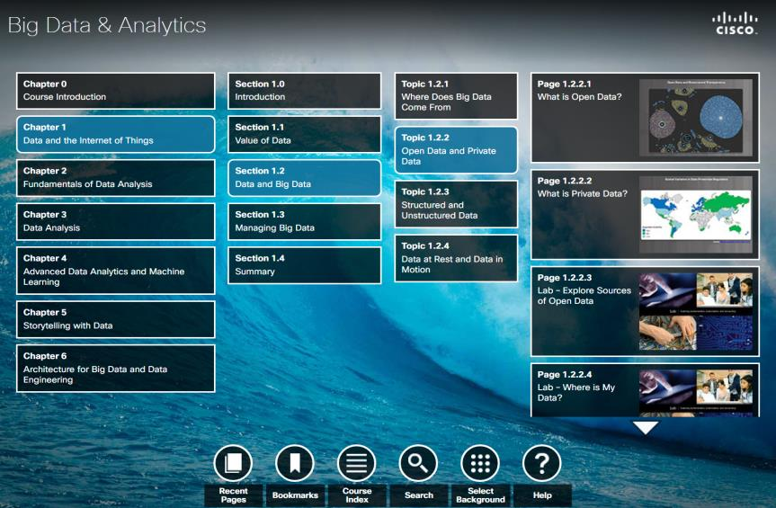
IoT Fundamentals:
Big Data & Analytics
Course Overview
Students will learn how to use Python data libraries to create a pipeline
to acquire, transform and visualize data collected from IoT sensors and
machines.
Benefits
The transformative element of any IoT system is the data that can be
collected from it. Thus the ability to extract data and using data
analytics techniques to gain insights increases employability.
Learning Components
Features
Target Audience: Secondary, Vocational, 2-year and 4-year
•
Use Python to read data from
•
Explain the fundamental
College, 4-Year University students
sensors and store data in a SQL
principles of a modern scalable
Prerequisites: IoT Fundamentals: Connecting Things
data base.
Big Data platforms like Hadoop.
Languages: English
•
Use Python Data Analysis library
•
Use storytelling to present the
Course Delivery: Instructor-led
to clean, manipulate, integrate
insights gained from extracted
Estimated Time to Complete: 40-50 hours
data sets.
data.
Use Python Visualization Libraries
Recommended Next Course: IoT Fundamentals: Hackathon
•
Playbook
to visualize real-time data end
explore acquired data sets.
Instructor Training: Required
© 2017 Cisco and/or its affiliates. All rights reserved. Cisco Confidential
12

Slide 10
Big Data & Analytics Course Outline
Chapter
Big Data & Analytics
Summary Description
1
Data and the Internet of Things
Understand the concepts of Big Data and Analytics, and the role of Big Data in IoT
systems.
2
Fundamentals of Data Analysis
Learn the basics of descriptive statistics, the practical aspects in acquiring data from
a sensor and how to create visual representations of the data.
3
Data Analysis
Explore data using visualization to extract information and create hypotheses.
4
Introduction to Machine Learning
Learn about predictive analytics, the supervised and unsupervised approaches to
machine learning and how to apply models to make predictions from the data.
5
Storytelling with Data
Learn how to transform analytics results into a clear and convincing narrative and
visual communication.
6
Architecture for Big Data and Data
Learn the basic principles behind the most important scalable solutions for Big Data
Engineering
such as Apache Hadoop and the related ecosystem of technologies.
© 2017 Cisco and/or its affiliates. All rights reserved. Cisco Confidential
30

Slide 11
IoT Fundamentals:
Hackathon Playbook
Course Overview
The Hackathon Playbook is a comprehensive framework of tools and
templates to prepare and run a Hackathon as a result of best practices and
lessons-learned collected from the global execution of IoT Hackathons within
Networking Academy and by other organizers.
Benefits
Student reinforce and deepen their multidisciplinary IoT and data skills by
defining, designing, prototyping and presenting an IoT solution to a panel of
industry experts and peers.
Learning Components
Features
Target Audience: Secondary, Vocational, 2-year and 4-year
•
Inspiration: understand, select and
help an expert understand the
College, 4-Year University students
present the problem to be solved to
concept and prototyping needs.
Prerequisites: IoT Fundamentals: Connecting Things and/or
recruit fellow partners.
•
Testing: present the concept and
Big Data and Analytics
•
Ideation: invent a concept that
validate the prototype with a second
Languages: English
doesn’t already exist to solve a social
expert, including user experience and
issue. Learn how to present the
enhancements.
Course Delivery: Instructor-led
solution to experts who will mentor
•
Presentation: present the solution
Estimated Time to Complete: 20-30 hours
students.
and demo the prototypes to an expert
Recommended Next Course: any Career-Ready offering
•
Prototyping: create a prototyping
panel.
from Cisco or an industry IoT training program
action plan, including objects and
© 2017 Cisco and/or its affiliates. All rights reserved. Cisco Confidential
14
visuals to illustrate their plan and will
Instructor Training: Required

Slide 12
The Networking Academy Learning Portfolio
Current & Planned
Collaborate for Impact
Certification-aligned
Packet Tracer
Regional
* Available within 12 months
Know How
Packet Tracer
Hackathons
IT Competitions
NetRiders
Internships
Exploratory
Foundational
Career-Ready
CCNA R&S Intro to Networks R&S Essentials,
Networking
Networking Essentials
Scaling Networks Connecting Networks
Mobility Fundamentals
CCNP R&S Switch Route TShoot
Security
Introduction to Cybersecurity
Cybersecurity Essentials
CCNA Security
CCNA Cyber Ops*
IoT Fundamentals Connecting Things
IoT
Introduction to IoT
Big Data and Analytics
Hackathon Playbook
OS & IT
NDG Linux Unhatched
NDG Linux Essentials
NDG Linux I
IT Essentials
NDG Linux II
Programming
Programming Essentials in C
Programming in C*
Programming Essentials in C++
Programming in C++*
Python*
Business
Be Your Own Boss
Entrepreneurship
Digital
Literacy
Get Connected
© 2017 Cisco and/or its affiliates. All rights reserved. Cisco Confidential
15
February 2017

Slide 13
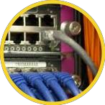
New Academies and/or
Existing Networking
New Departments
Academies
at Existing Academies
Process Control
Engineering
Information
Technology
Energy
Industrial
1M Students
Management
Automation
20K Instructors
9K Academies
Transportation
Engineering
© 2017 Cisco and/or its affiliates. All rights reserved. Cisco Confidential
17

Slide 14
IoT Fundamentals Approach
A Multidisciplinary Digital Foundation
…For Many IoT Career-Ready Pathways
IoT Fundamentals
…
IoT Data Analyst
…
IoT Product Manager
…
IoT Device Management
…
IoT Security
Electronics
Cybersecurity
Programming
Problem solving
and many others
Networking
Design thinking
Data Analytics
Soft skills
© 2017 Cisco and/or its affiliates. All rights reserved. Cisco Confidential
18

Slide 15
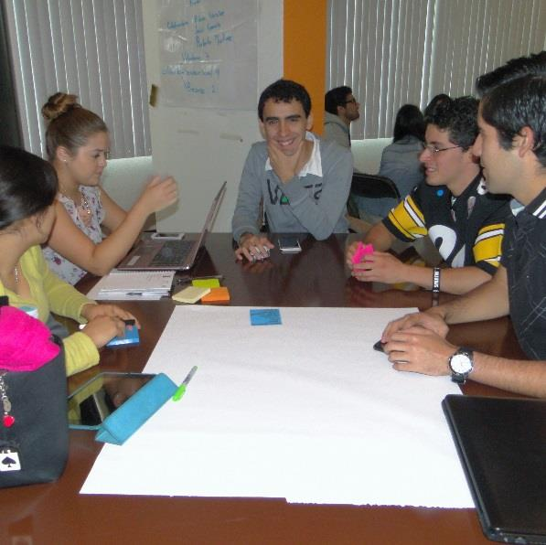
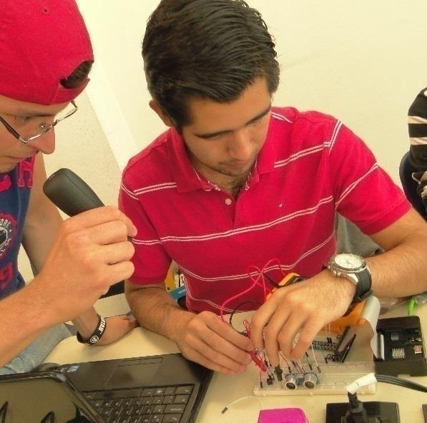
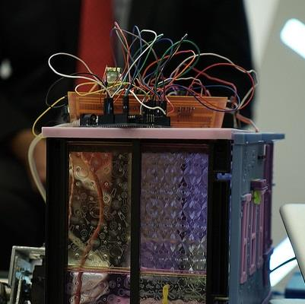
A New NetAcad Hands-On Experience
IoT Fundamentals | Lab Experiences
Analyze the Problem
Hands-on
Design Thinking and
with User Focus
Maker Approach and
Rapid Prototyping, Iterating,
Business and Social Impact view
Enterprise grade
Presenting
Technologies
© 2017 Cisco and/or its affiliates. All rights reserved. Cisco Confidential
19

Slide 16
IoT Fundamentals Examples
of Career-Ready Pathways
A+
Cisco
Cisco
Certification
CCENT
CCNA R&S
Ex. Infrastructure Program at
Intro to
CCNA R&S
CCNA R&S
a 2-Yr / Vocational College
Cybersecurity
IT Essentials
(ITN and RSE)
(ScaN and CN)
IoT
Fundamentals
Computer
Networking
Network
Technician
Technician
Administrator
Capstone
DBMS/SQL
Python
Course
Ex. Data Science program at
Foundational
IoT
Getting and
Advanced
Scalable
4-Yr College/University
Course
Fundamentals
Cleaning Data
Visualization
Machine
Learning
Unique Program Courses
offered by College/University
Ex. Robotics program at
Intro to
IoT
Unique Skills for entry into post-secondary degree or training
IoT
Fundamentals
programs, for ex.
Secondary School
Engineering
Data Science
Robotics Course Curriculum
IoT Infrastructure
Cybersecurity
IoT Fundamentals Academy support resources include
shared implementation scenarios across our community
Certification
© 2017 Cisco and/or its affiliates. All rights reserved. Cisco Confidential
23

Slide 17
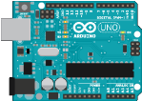
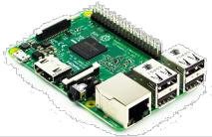
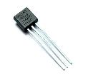
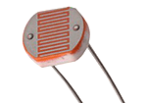
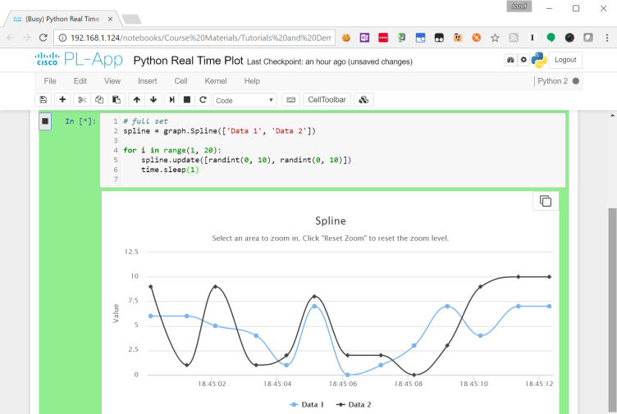
Cisco Prototyping Lab
Tool Overview
Career Prep
Learning Components
The Cisco Prototyping Lab is a
Provides an easy to use,
•
Prototyping Lab App
comprehensive learning environment
comprehensive learning environment
•
Prototyping Lab Kit
created by Cisco for Networking
using real devices, code, coding tools
•
Raspberry Pi 3 CanaKit Ultimate
Academy students to learn and practice
and data that students use to create
Starter Kit (or equivalent)
key aspects of the foundational IoT
the physical interconnection of an
technologies. Using an engaging,
end-to-end IoT and the logical data
•
SparkFun Inventor’s Kit for Arduino
hands-on approach, it supports both the
pipeline to acquire, analyze and
v3.3 (or equivalent)
learning and creative phases of the
present data.
•
Cables, sensors & actuators
Networking Fundamentals curriculum.
Features
As an integral part of the Networking Academy learning
experience, Cisco Prototyping Lab provides
•
Interactive labs using Jupyter Notebook
•
Visual programming with Blockly
•
Device programming with Python
•
Data visualization & analytics
•
Connected applications via APIs
© 2017 Cisco and/or its affiliates. All rights reserved. Cisco Confidential
33
•
Rapid Prototyping

Slide 18
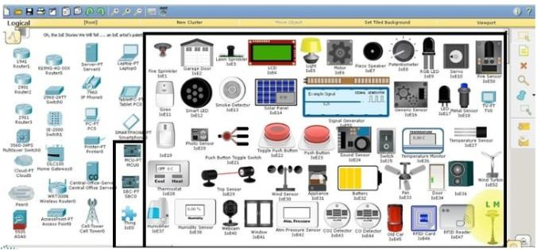
Packet Tracer
Tool Overview
Career Prep
Learning Components
Packet Tracer is an innovative
The Packet Tracer simulation-based
•
Cisco Packet Tracer (PT)
simulation and visualization tool used
learning environment promotes the
•
PT Mobile Android
for lectures, labs, games, homework,
development of essential career skills
•
PT Mobile iOS
assessments, and competitions. It is
ranging from teamwork and critical
embedded in these courses:
thinking to creative problem solving.
•
PT Games
•
CCNA Routing
•
Intro to the
and Switching
Internet of
•
CCNA Security
Things
•
IT Essentials
•
Mobility
Fundamentals
Features
As an integral part of the Networking Academy learning
experience, Packet Tracer provides
•
Simulation
•
Visualization
•
Authoring
•
Assessment
•
Collaboration capabilities and facilitates the teaching and
© 2017 Cisco and/or its affiliates. All rights reserved. Cisco Confidential
34
learning of complex technology concepts.

Slide 19
How to get involved
Start building the pipeline of needed ICT professionals with Cisco Networking Academy courses at your campus or organization
Help your students prepare for entry-level career opportunities, continuing education, industry-recognized certifications, and career advancement
For more information, visit www.NetAcad.com

