Slide 1
Earthquake resistant buildings
Prepared by
Prof Dr. Bayan Salim
Ishik University

Slide 2
Earthquake resistant buildings
Contents:
1. Max ground accelerations
2. Basic principle and parameters
3. Structural response
4. Structural considerations
4.1 Frequency vs. geometry
4.2 Discontinuity in geometry
4.3 Vertical, plan geometries
4.4 Stiffer members
4.5 Separation between structures
5. Member considerations
5.1 Concrete confinement
5.2 Ductile hinge formation
5.3 Beam-column joints

Slide 3
Maximum considered ground accelerations
Regions adjacent to active fault lines are the most prone to experience earthquakes.
Maps show the maximum ground acceleration, S s expressed as a % of gravity, represent the expected peak acceleration of a single-degree-of-freedom system with a 0.2 sec period and 5 percent of critical damping; known as the 0.2 sec spectral response acceleration Ss (subscript S for short period),
Ss is used, along with the 1.0 sec spectral response acceleration S 1 (mapped in a similar manner), to establish the loading criteria for seismic design.
Accelerations S S and S 1 are based on historical records and local geology.

Slide 4
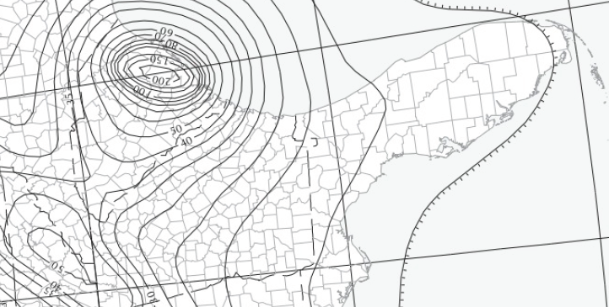
Map
Seismic Map
Showing
Ss

Slide 5
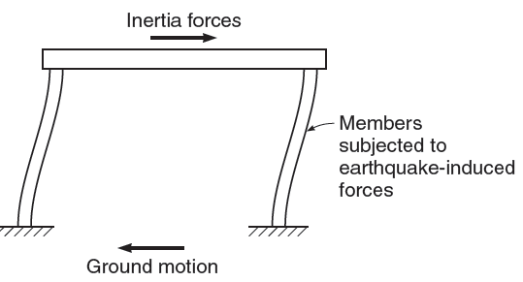
Basic principle
As the ground moves, inertia tends to keep structures in place, resulting in the imposition of displacements and forces that can have catastrophic results.

Slide 6
Design parameters
Although peak acceleration is an important design parameter, the frequency characteristics and duration of an earthquake are also important; the closer the frequency of the earthquake motion is to the natural frequency of a structure and the longer the duration of the earthquake, the greater the potential for damage.
The purpose of seismic design is to proportion structures so that they can withstand the displacements and the forces induced by the ground motion.

Slide 7
Structural Response
the goal of earthquake design has been to construct buildings that will withstand moderate earthquakes without damage and severe earthquakes without collapse.
Without careful design, forces and displacements can be concentrated in portions of a structure that are not capable of providing adequate strength or ductility
- Structural Considerations
- Member Considerations

Slide 8
Structural Considerations –1 Frequency vs. geometry
Earthquake response depends strongly on the geometric properties of a structure, especially height.
Tall buildings respond more strongly to long-period (low-frequency) ground motion, while
Short buildings respond more strongly to short-period (high-frequency) ground motion.

Slide 9
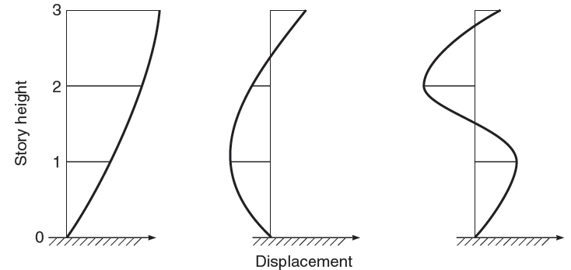
Structural Considerations –1 Frequency vs. geometry
The taller a structure, the more susceptible it is to the effects of higher modes of vibration, which are generally additive to the effects of the lower modes and tend to have the greatest influence on the upper stories.

Slide 10
Structural Considerations –1 Frequency vs. geometry
Top floors collapse, Hotel Continental, Mexico

Slide 11
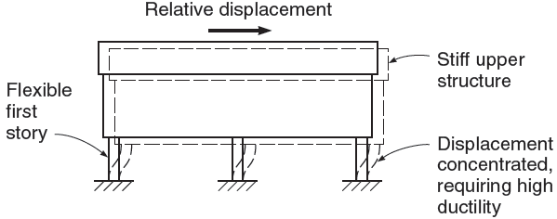
Structural Considerations –2 Discontinuity in geometry
Structures with a discontinuity in stiffness or geometry can be subjected to undesirably high displacements or forces. The discontinuance of shear walls or infill walls, at a particular story level, will have the result of concentrating the displacement in this “soft”story.

Slide 12
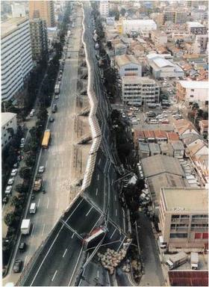
Structural Considerations –2 Discontinuity in geometry
Columns fail in shear due to stiff upper structure, Kobe, Japan

Slide 13
Structural Considerations –2 Discontinuity in geometry
Damage to Soft story

Slide 14
Structural Considerations –2 Discontinuity in geometry
Failure due to Soft Story in Gulcuk, Turkey

Slide 15
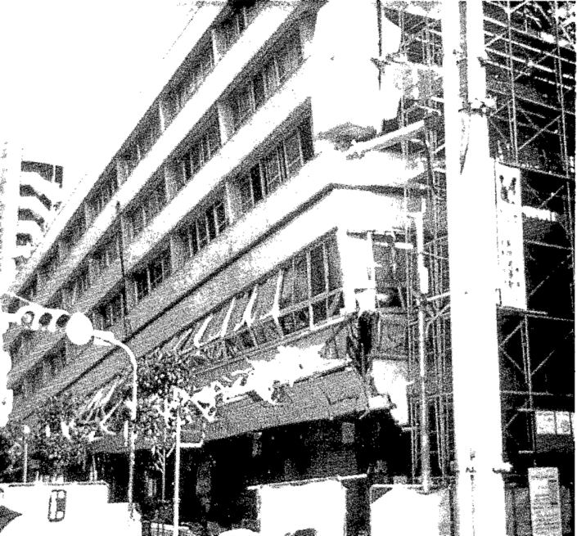
Structural Considerations –2 Discontinuity in geometry
Soft intermediate story failure, Kobe, Japan

Slide 16
Structural Considerations –2 Discontinuity in geometry
Soft open-garage story failure,

Slide 17
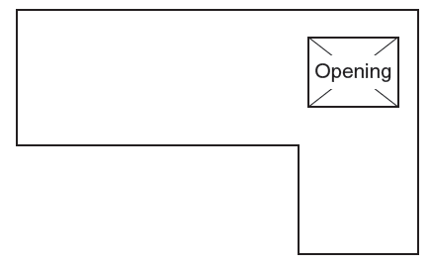
Structural Considerations –3 Vertical, plan Irregularities
Structures with vertical geometric
and plan irregularities, will result in torsion induced by ground motion

Slide 18
Structural Considerations –3 Vertical, plan Irregularities

Slide 19
Structural Considerations –4 Stiffer Members
Within a structure, stiffer members tend to pick up a greater portion of the load.
When a frame is combined with a shear wall, this can have the positive effect of reducing the displacements of the structure and decreasing both structural and nonstructural damage.

Slide 20
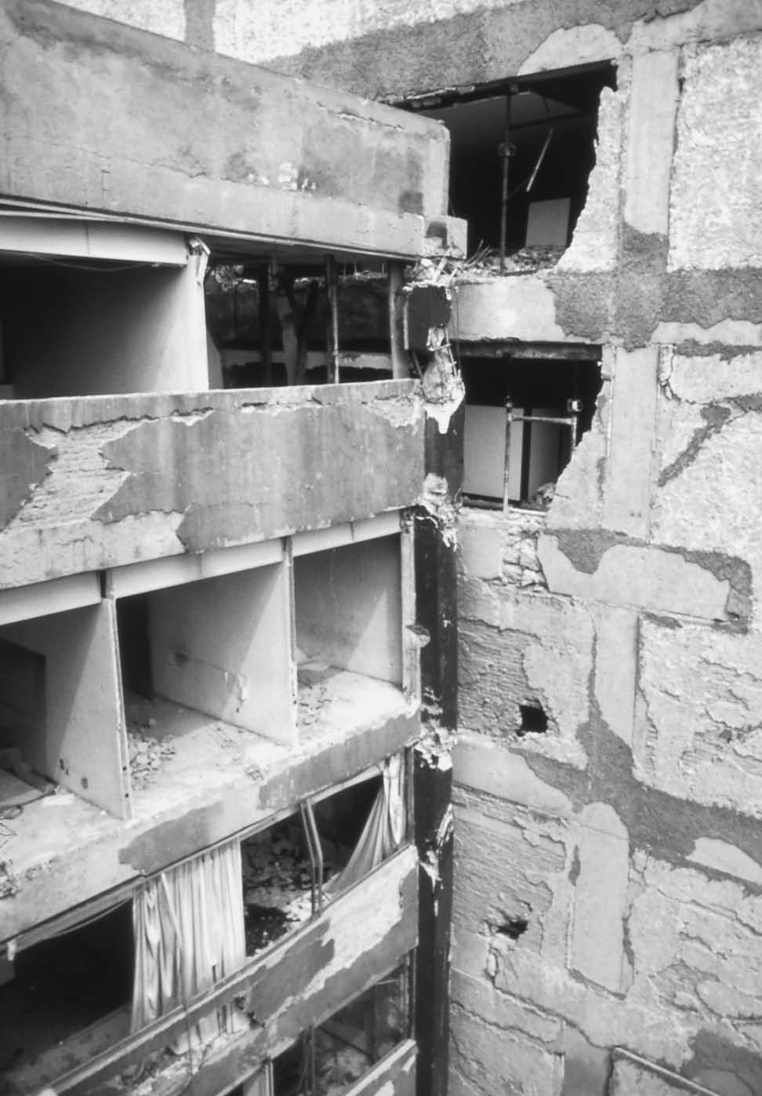
Structural Considerations –5 Separation bet. structures
It is needed to provide
Adequate separation between
structures.
Lateral displacements can result
in structures coming in contact
during an earthquake, resulting
in major damage due to
hammering

Slide 21
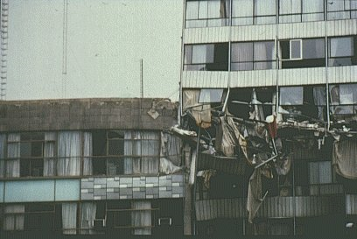
Structural Considerations –5 Separation bet. structures
Two buildings pound each other, Mexico city

Slide 22
Member Considerations -1
Members designed for seismic loading must perform in a ductile fashion and dissipate energy in a manner that does not compromise the strength of the structure. Both the overall design and the structural details must be considered to meet this goal.

Slide 23
Member Considerations -1 Concrete confinement
When confinement is provided, through closed hoops and spirals, beams and columns can undergo nonlinear cyclic bending while maintaining their flexural strength and without deteriorating due to diagonal tension cracking.

Slide 24
Member Considerations -2 Ductile hinge formation
Structures should be proportioned so that hinges occur at locations that least compromise strength.
the flexural capacity of the members at a joint should be such that the columns are stronger than the beams. Strong column-weak beam approach
In this way, hinges will form in the beams rather than the columns, minimizing the portion of the structure affected by nonlinear behavior and maintaining the overall vertical load capacity

Slide 25
Member Considerations-2 Strong beam-weak column failure

Slide 26
Member Considerations-2 strong beam-weak column failure
Bhuj, 2001

Slide 27
Member Considerations-2 strong beam-weak column failure

Slide 28
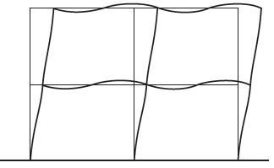
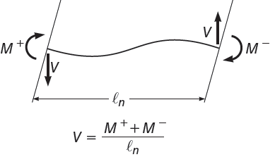
Member Considerations -2 Ductile hinge formation
When hinges form in a beam, the shear that must be carried is determined by the end moments of the member:
Transverse reinforcement must be added to avoid diagonal cracks and maintain a ductile hinge.

Slide 29
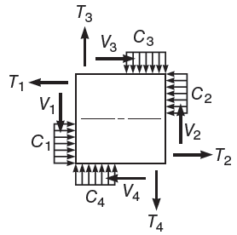
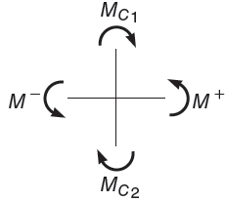
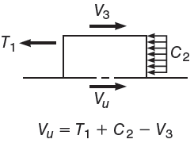
Member Considerations -3 Beam-Column Joint
Beam-column joints undergo high shear stresses because of the change from positive to negative bending in the flexural members from one side of the joint to the other,
It must be ensured that joints not only have adequate strength but are also constructible.

Slide 30
Member Considerations -3 Beam-Column Joint
Congestion of reinforcement at a girder-column joint

